Slide 1

Heart Failure Prediction Using ANN
Presented By Umm-E-Mahnoor
Presented to : Dr. Jawwad Baig

Slide 2
Dataset : Kaggle
Features:
Age
Anemia
CPK Level
Diabetes
Ejection Fraction
High Blood Pressure
Platelets
Serum Creatinine
Serum Sodium
Sex
Smoking
Follow-up Time
Target Variable :
DEATH_EVENT (Boolean)

Slide 3
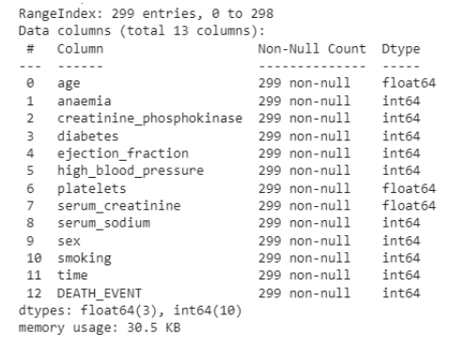
Data Loading and Exploration
Utilized pandas(Library) for loading the dataset.
Checked for missing values (No missing values in the dataset).
Examined data types (float64 and int64).

Slide 4
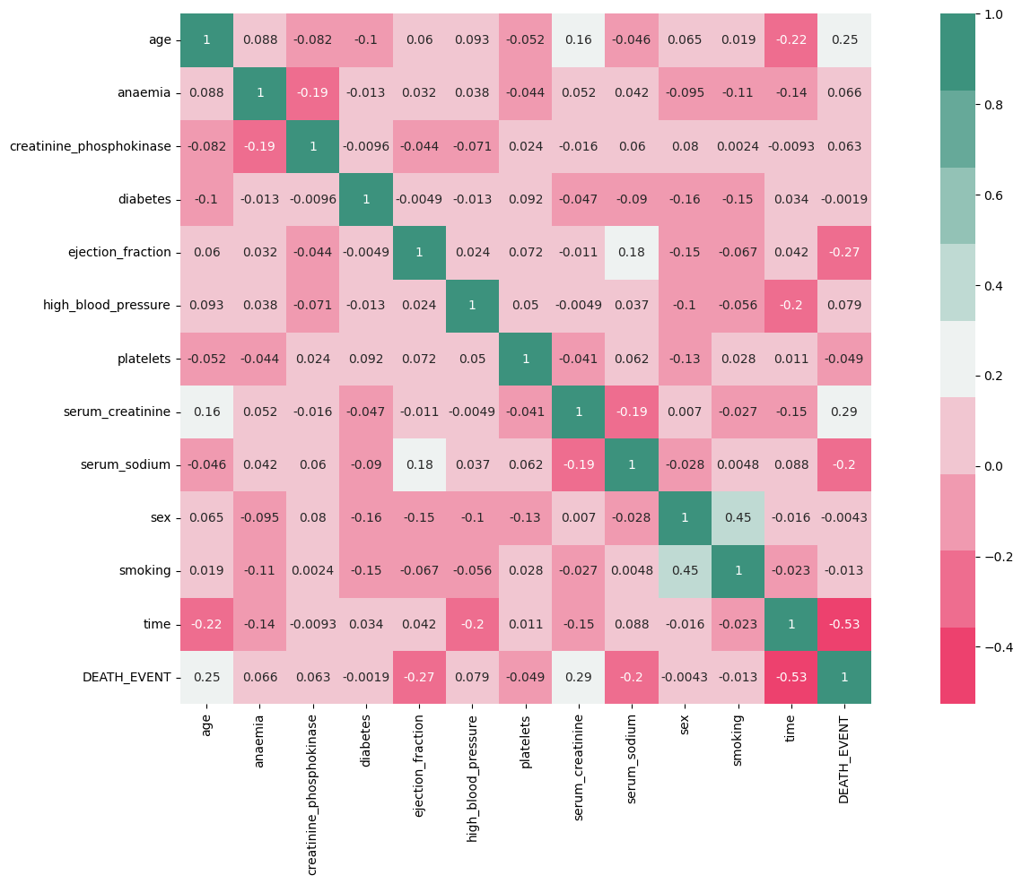
Bivariate Analysis
Time is the most important feature as Evident from the inverse relationship
Serum Creatinine is the next important feature in blood makes it easier for heart to function.
Ejection Fraction has also significant influence on target variable which is expected since it is basically the efficiency of the heart.
Age Can be seen from the inverse relation pattern that heart's functioning declines with ageing.

Slide 5
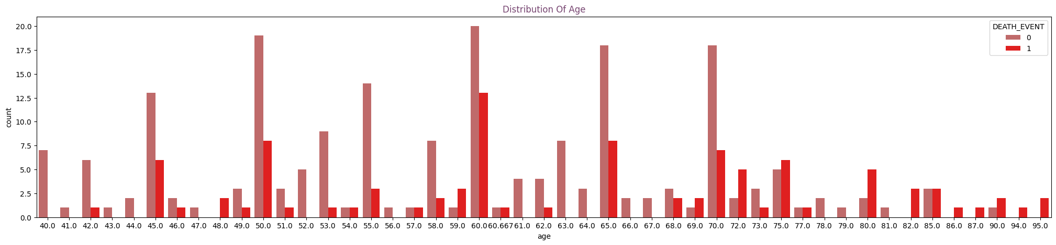
Evaluating age distribution

Slide 6
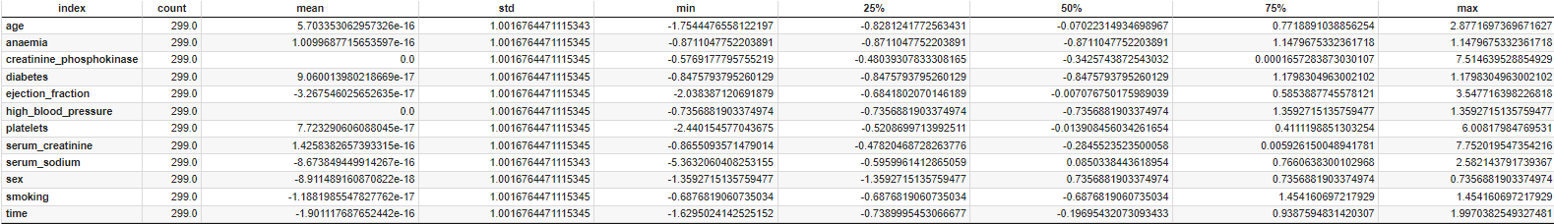
Data Preprocessing
Applied standard scaling to features using sklearn’s StandardScaler.
Split the dataset into training (70%) and testing (30%) sets.

Slide 7
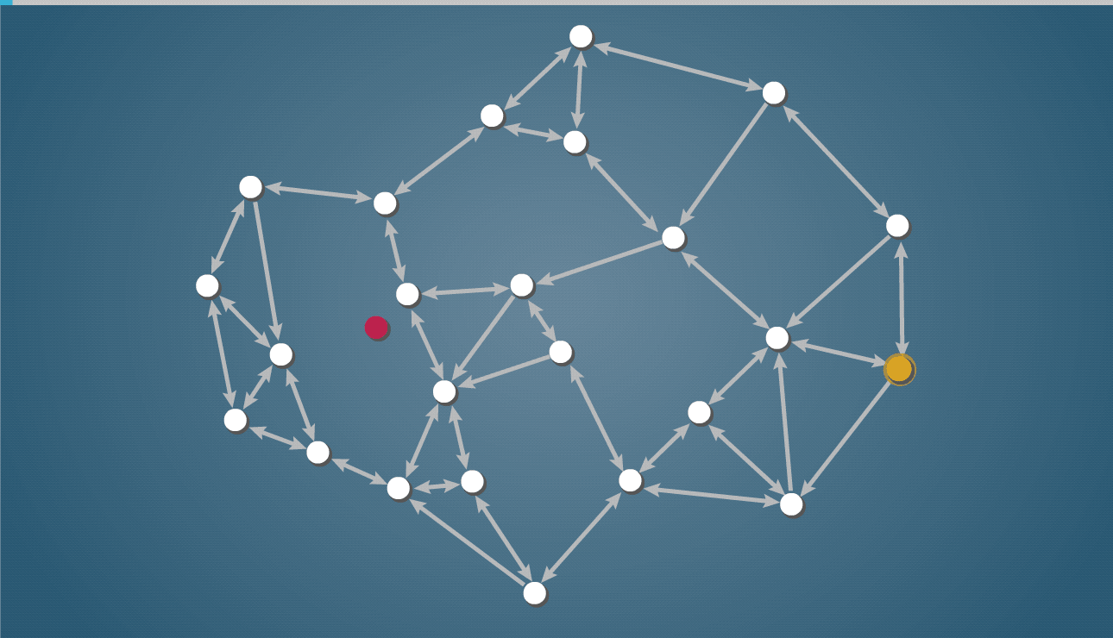
Model Building - Artificial Neural Network (ANN)
Implemented an ANN model using Keras and TensorFlow.
Architecture: 3 hidden layers with dropout layers.
Activation functions: 'relu' for hidden layers, 'sigmoid' for the output layer.
Compiled using 'adam' optimizer and 'binary_crossentropy' loss function.
Trained for 50 epochs with early stopping to prevent overfitting.

Slide 8
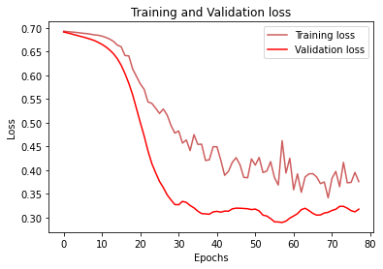
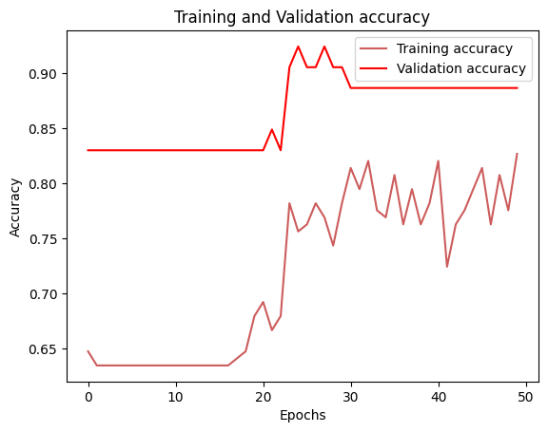
Model Evaluation
Achieved a validation accuracy of 86.45%.
Plotted training and validation loss, as well as accuracy curves.

Slide 9
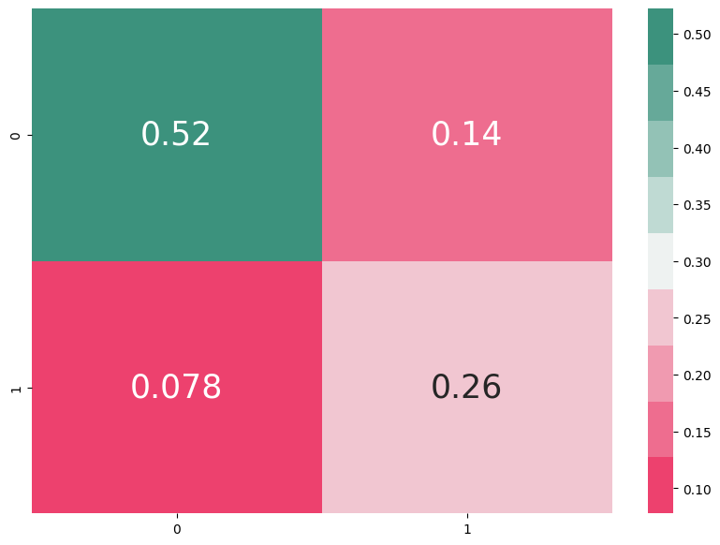
Predicting Accuracy
- The developed ANN model demonstrates promising results in predicting heart failure.
F1-Score : 79%

Slide 10


